Slide 1
Operating Systems
Chapter 12 File Management

Slide 2
Agenda
12.1 Overview
12.2 File Organization and Access
12.3 File Directories
12.4 File Sharing
12.5 Record Blocking
12.6 Secondary Storage Management
12.7 Summary

Slide 3
File Management
File management system consists of system utility programs that run as privileged applications(特权程序)
Provides a means of data I/O
  Input to applications is by means of a file
  Output is saved in a file for long-term storage
Notes:
system utility programs 系统功能程序

Slide 4
File System Properties(文件系统的特性)
Long-term existence (长期存在)
Sharable between processes (进程共享)
Structure (结构化存储)
  Have specific structure according to application
Notes:
结构:取决于具体的文件系统，一一个文件具有针对某个特定应用的内部结构。

Slide 5
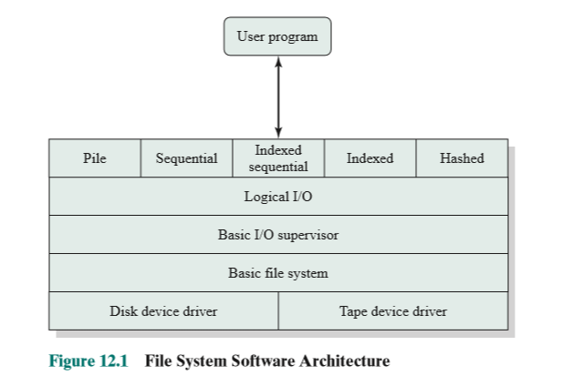

Slide 6
File Operations(文件操作)
Create
Delete
Open
Close
Read
Write

Slide 7
Terms Used with Files (文件术语)
Field (域)
  Basic element of data(基本数据单元)
  Contains a single value
  Characterized by its length and data type
Record (记录)
  Collection of related fields(相关域的集合)
  Treated as a unit
    Example: employee record

Slide 8
Terms Used with Files
File (文件)
  Collection of similar records
  Treated as a single entity
  Have file names
  May restrict access
Database (数据库)
  Collection of related data
  Relationships exist among elements

Slide 9
File Management Systems (文件管理系统)
The way a user of application may access files(用户和程序使用文件的唯一方式)
Programmer does not need to develop file management software

Slide 10
File Management Functions
Identify (标识) and locate (定位) a selected file
  Use file name to identify files
  Use a directory (目录) to describe the location of all files plus their attributes (属性)
On a shared system describe user access control (存取控制)
Blocking (块化) for access to files
Manage free blocks
  Allocate free blocks to files (空闲块分配)
  Reclaim free blocks (空闲块回收)

Slide 11
Agenda
12.1 Overview
12.2 File Organization and Access
12.3 File Directories
12.4 File Sharing
12.5 Record Blocking
12.6 Secondary Storage Management
12.7 Summary

Slide 12
12.2 File Organization and Access
12.2.1 Criteria for File Organization
12.2.2 The Pile
12.2.3 The Sequential File
12.2.4 The Indexed Sequential File
12.2.5 The Indexed File
12.2.6 The Direct or Hashed File

Slide 13
Criteria for File Organization (文件管理的评价标准)
Short access time (短的存取时间)
Ease of update (易于修改)
Economy of storage (存储经济性)
Simple maintenance (维护简单)
Reliability (可靠性)

Slide 14
12.2 File Organization and Access
12.2.1 Criteria for File Organization
12.2.2 The Pile
12.2.3 The Sequential File
12.2.4 The Indexed Sequential File
12.2.5 The Indexed File
12.2.6 The Direct or Hashed File

Slide 15
The Pile (堆文件)
The Pile
  Data are collected in the order they arrive
  Purpose is to accumulate a mass of data and save it
  Records may have different fields
  No structure
  Record access is by exhaustive search (穷举搜索)

Slide 16
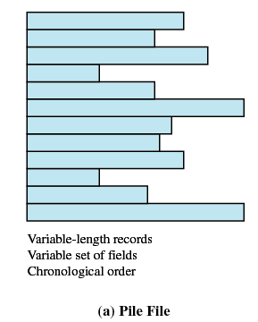
The Pile
按时间的前后顺序排列
Notes:
chronological按时间的前后顺序排列的

Slide 17
12.2 File Organization and Access
12.2.1 Criteria for File Organization
12.2.2 The Pile
12.2.3 The Sequential File
12.2.4 The Indexed Sequential File
12.2.5 The Indexed File
12.2.6 The Direct or Hashed File

Slide 18
The Sequential File (顺序文件)
All fields the same (order and length)
  Field names and lengths are attributes of the file
All records the same length
One field is the key filed (关键域，关键字)
  Uniquely identifies the record
  Records are stored in key sequence

Slide 19
The Sequential File
New records are placed in a log file(日志文件) or transaction file(事务文件)
Batch update (成批更新) is performed to merge(合并) the log file with the master file

Slide 20
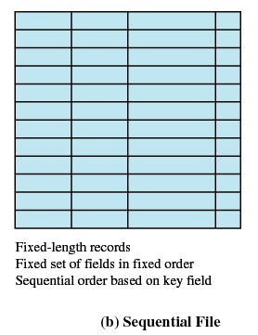
The Sequential File

Slide 21
12.2 File Organization and Access
12.2.1 Criteria for File Organization
12.2.2 The Pile
12.2.3 The Sequential File
12.2.4 The Indexed Sequential File
12.2.5 The Indexed File
12.2.6 The Direct or Hashed File

Slide 22
The Indexed Sequential File (索引顺序文件)
Sequential file + index + overflow file
Index provides a lookup capability to quickly reach the vicinity of the desired record (索引提供了快速接近目标记录的查询能力)
  Index contains a key field and a pointer to the main file
  Indexed is searched to find highest key value that is equal to or precedes the desired key value (索引查找关键字小于或者等于目标关键字的最大记录)
Notes:
vicinity 附近

Slide 23
The Indexed Sequential File (索引顺序文件)
Comparison of sequential and indexed sequential
  Example: a file contains 1000000 records
  On average 500000 accesses are required to find a record in a sequential file
  If an index contains 1000 entries and each entries contains 1000 pointers to main file, it will take on average 500 accesses to find the key, followed by 500 accesses in the main file. Now on average it is 1000 accesses

Slide 24
Overflow File of The Indexed Sequential File
New records are added to an overflow file(溢出文件)
Record in main file that precedes it is updated to contain a pointer to the new record
The overflow is merged (合并) with the main file during a batch update
Multiple level indexes (多级索引) for the same key field can be set up to increase efficiency

Slide 25
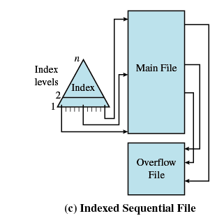
Indexed Sequential File

Slide 26
12.2 File Organization and Access
12.2.1 Criteria for File Organization
12.2.2 The Pile
12.2.3 The Sequential File
12.2.4 The Indexed Sequential File
12.2.5 The Indexed File
12.2.6 The Direct or Hashed File

Slide 27
The Indexed File (索引文件)
Uses multiple indexes for different key fields
May contain an exhaustive index(完全索引) that contains one entry for every record in the main file
May contain a partial index(部分索引)
Index files itself are sequential file

Slide 28
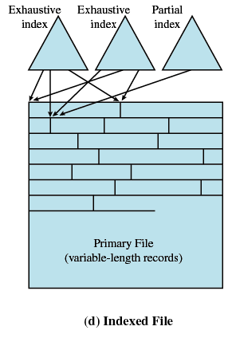
The Indexed File

Slide 29
12.2 File Organization and Access
12.2.1 Criteria for File Organization
12.2.2 The Pile
12.2.3 The Sequential File
12.2.4 The Indexed Sequential File
12.2.5 The Indexed File
12.2.6 The Direct or Hashed File

Slide 30
The Direct or Hashed File(直接文件或者散列文件)
Directly access a block at a known address
Key field required for each record
Hash based on the key field

Slide 31
Agenda
12.1 Overview
12.2 File Organization and Access
12.3 File Directories
12.4 File Sharing
12.5 Record Blocking
12.6 Secondary Storage Management
12.7 Summary

Slide 32
12.3 File Directories
12.3.1 Contents
12.3.2 Structure
12.3.3 Naming

Slide 33
File Directories
Contains information about files
  Attributes (属性)
  Location (位置)
  Ownership (所有者)
Directory itself is a file owned by the operating system(一个目录本身是一个文件)
Provides mapping between file names and the files themselves(提供文件名和文件之间的映射)

Slide 34
12.3 File Directories
12.3.1 Contents
12.3.2 Structure
12.3.3 Naming

Slide 35
Simple Structure for a Directory (简单目录结构)
Represented by a simple sequential file with the name of the file serving as the key (用顺序文件代表目录，该目录下的文件名做该顺序文件的关键字)
Forces user to be careful not to use the same name for two different files (文件不能重名)

Slide 36
Two-level Scheme for a Directory(两级目录方案)
A master directory (主目录)
One directory for each user (用户目录)
Master directory contains entry for each user
  Provides address and access control information
Each user directory is a simple list of files for that user
Still provides no help in structuring collections of files （不能建子目录）

Slide 37
Hierarchical, or Tree-Structured Directory (层次/树状结构目录)
Master directory with user directories underneath it
Each user directory may have subdirectories and files as entries
Notes:
underneath 下面层次的

Slide 38
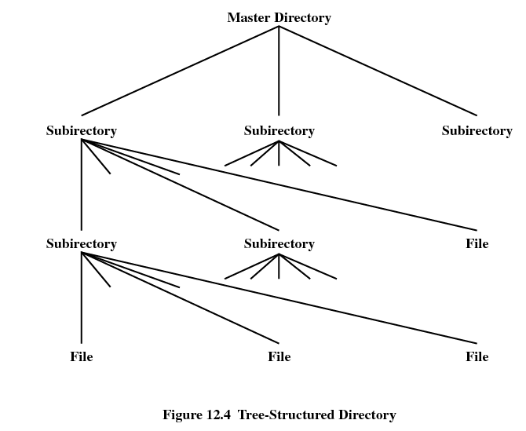

Slide 39
12.3 File Directories
12.3.1 Contents
12.3.2 Structure
12.3.3 Naming

Slide 40
Hierarchical, or Tree-Structured Directory
Files can be located (文件定位) by following a path from the root, or master, directory down various branches
  This is the pathname for the file
Can have several files with the same file name (文件同名) as long as they have unique path names

Slide 41
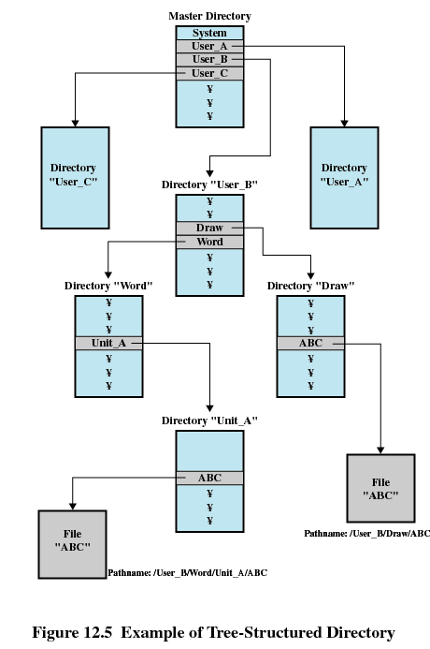

Slide 42
Hierarchical, or Tree-Structured Directory
Pathname(路径名)
Current directory is the working directory (工作目录)
Files are referenced relative to the working directory (相对路径)

Slide 43
Agenda
12.1 Overview
12.2 File Organization and Access
12.3 File Directories
12.4 File Sharing
12.5 Record Blocking
12.6 Secondary Storage Management
12.7 Summary

Slide 44
File Sharing
In multiuser system, allow files to be shared among users
Two issues
  Access rights (存取权限)
  Management of simultaneous access (同时存取控制)

Slide 45
Access Rights
None(无)
  User may not know of the existence of the file
  User is not allowed to read the user directory that includes the file
Knowledge(知道)
  User can only determine that the file exists and who its owner is

Slide 46
Access Rights
Execution(执行)
  The user can load and execute a program but cannot copy it
Reading(读)
  The user can read the file for any purpose, including copying and execution
Appending(追加)
  The user can add data to the file but cannot modify or delete any of the file’s contents

Slide 47
Access Rights
Updating(更新)
  The user can modify, deleted, and add to the file’s data. This includes creating the file, rewriting it, and removing all or part of the data
Changing protection(更改保护)
  User can change access rights granted to other users
Deletion(删除)
  User can delete the file

Slide 48
Access Rights
Owners （所有者）
  Has all rights previously listed
  May grant rights to others using the following classes of users
    Specific user(指定用户)
    User groups(用户组)
    All for public files(所有用户)

Slide 49
Simultaneous Access(同时访问)
User may lock entire file when it is to be updated
User may lock the individual records during the update
Mutual exclusion and deadlock are issues for shared access

Slide 50
Agenda
12.1 Overview
12.2 File Organization and Access
12.3 File Directories
12.4 File Sharing
12.5 Record Blocking
12.6 Secondary Storage Management
12.7 Summary

Slide 51
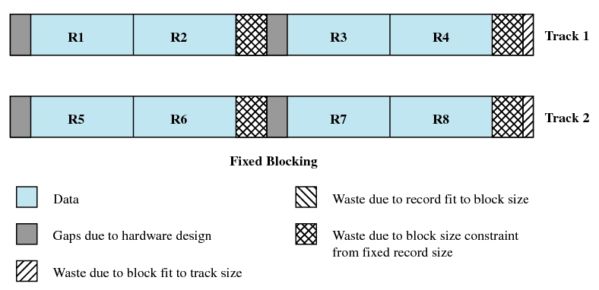
Fixed Blocking
Notes:
记录组块的方法 定长，块的末尾可能会有一些未使用的空间，称为内部碎片。

Slide 52
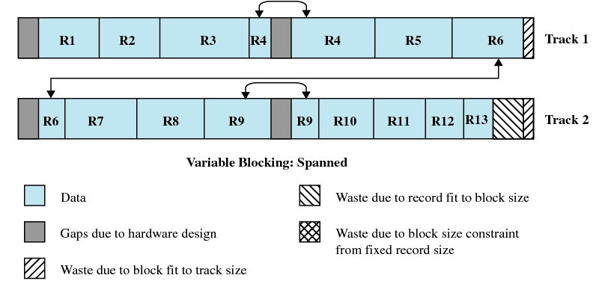
Variable-Length Spanned Blocking
Notes:
变长可跨越 定长组块是记录定长顺序文件的最常用方式。变长跨越式组块的存储效率高，并且对文件大
小没有限制，但这种技术很难实现。跨越两个块的记录需要两次I/O 操作，且不论如何组织，文
件都很难修改。

Slide 53
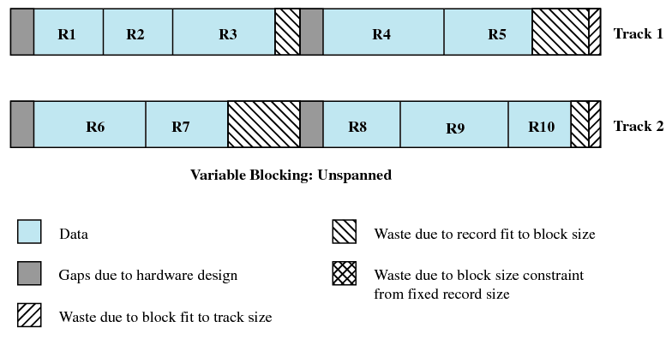
Variable-Length Unspanned Blocking
Notes:
变长非跨越 变长非跨越式组块会浪费空间，且存在记录的大小不能超过块的大小的限制。

Slide 54
Agenda
12.1 Overview
12.2 File Organization and Access
12.3 File Directories
12.4 File Sharing
12.5 Record Blocking
12.6 Secondary Storage Management
12.7 Summary

Slide 55
12.6 Secondary Storage Management(二级存储管理)
12.6.1 File Allocation
12.6.2 Free Space Management
12.6.3 Reliability

Slide 56
File Allocation Table(FAT)
FAT is used to track portions allocated to files
Notes:
跟踪分配给文件的分区

Slide 57
Preallocation (预分配) VS Dynamic allocation (动态分配)
Preallocation
  Need the maximum size for the file at the time of creation
  Difficult to reliably estimate the maximum potential size of the file
Dynamic allocation
  Allocates space to a file in portions as needed.

Slide 58
Contiguous allocation (连续分配)
Single set of blocks is allocated to a file at the time of creation (文件创建时分配一组连续的块)
Only a single entry in the file allocation table
  Starting block and length of the file
External fragmentation will occur
  Need to perform compaction

Slide 59

Contiguous allocation

Slide 60
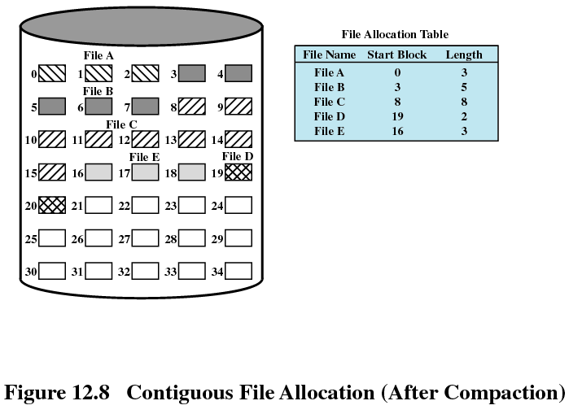
Contiguous allocation

Slide 61
Chained allocation (链式分配)
Allocation on basis of individual block(基于单个块进行分配)
Each block contains a pointer to the next block in the chain
Only single entry in the file allocation table
  Starting block and length of file
No external fragmentation
Best for sequential files (适合顺序文件)
No accommodation of the principle of locality (局部性原理不再适用)，so consolidation(迁移、集结) is need to move blocks adjacent each other

Slide 62
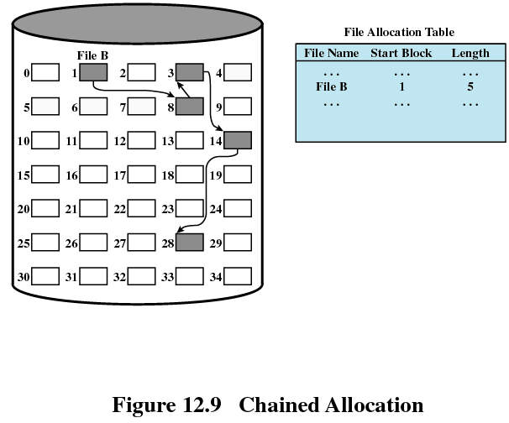
Chained allocation

Slide 63
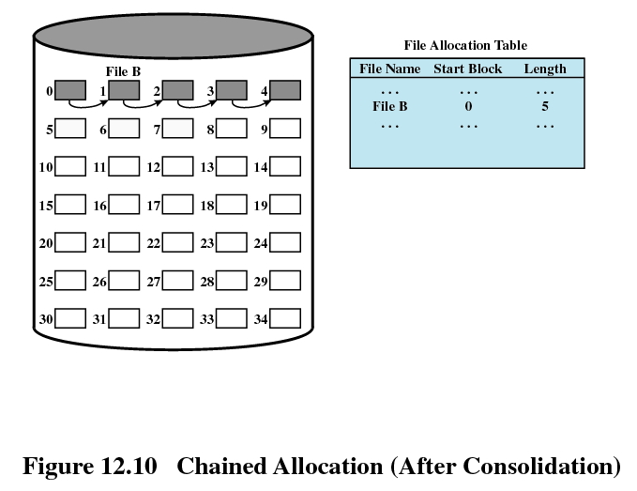
Chained allocation
Notes:
紧缩后

Slide 64
Indexed allocation (索引分配)
File allocation table contains a separate one-level index for each file (每个文件在文件分配表中有一个一级索引)
The file allocation table contains block number for the index (文件分配表指向该文件在磁盘上的索引块)
The index has one entry for each portion allocated to the file (分配给文件的每个分区都在索引中都有一个表项)
Indexed allocation supports both sequential and direct access to the file and thus is the most popular form of file allocation.

Slide 65
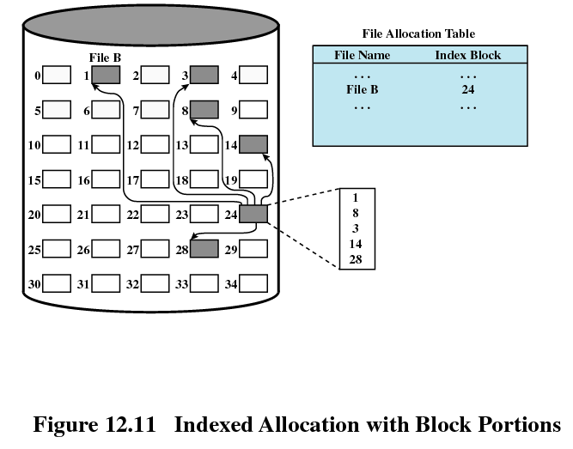
Indexed allocation
Notes:
基于块索引

Slide 66
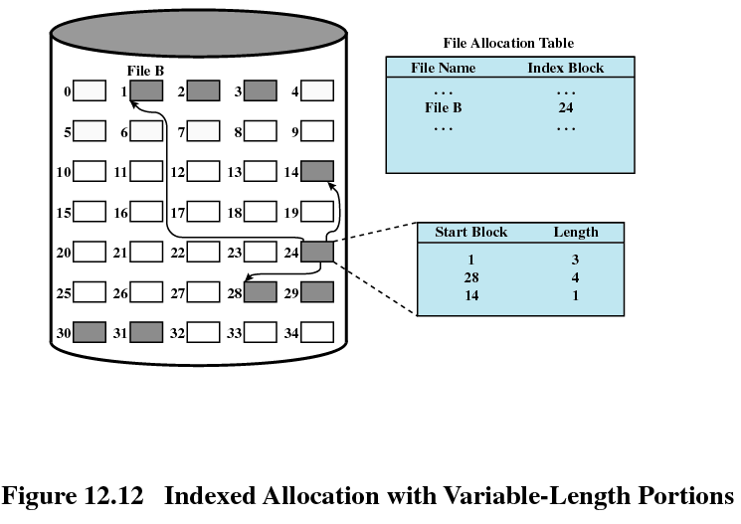
Indexed allocation
Notes:
基于长度可变的索引分区

Slide 67
12.6 Secondary Storage Management
12.6.1 File Allocation
12.6.2 Free Space Management
12.6.3 Reliability

Slide 68
Free Space Management
Bit tables (位表)
  Use a vector containing one bit for each block on the disk. Each entry of a 0 corresponds to a free block, and each 1 corresponds to a block in use.
Chained free portions (链式空闲区)
  The free portions may be chained together by using a pointer and length value in each free portion
Indexing (空闲索引表)
Free block list (空闲列表)
Notes:
空闲空间管理

Slide 69
12.6 Secondary Storage Management
12.6.1 File Allocation
12.6.2 Free Space Management
12.6.3 Reliability

